Slide 1
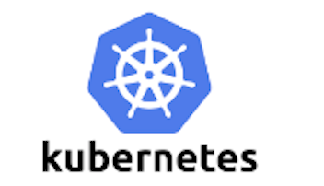


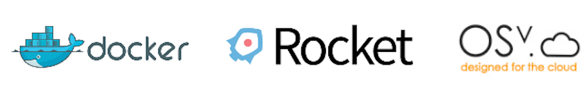


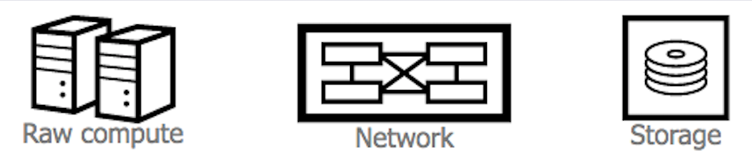
Container Ecosystem Layers
Layer 6
Development Workflow
Container Plat. Distribution
ICP
Layer 5
Orchestration/Scheduling
Service Model
Layer 4
Container Engine
Layer 3
Operating System
Layer 2
Virtual Infrastructure
Layer 1
Physical Infrastructure

Slide 2

Level Set :: Container Value Proposition
Platform for building, distributing and running applications
Lightweight container virtualization
10s of VMs => 100s, 1000s of containers per host

Slide 3

Everyone’s container journey starts with one container….

Slide 4
At first the growth is easy to handle….

Slide 5
But soon you have many applications, many instances…

Slide 6
And that is why there is container orchestration

Slide 7
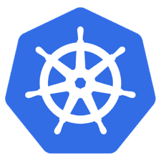
What is Kubernetes?
Container orchestrator
Runs and manages containers
Unified API for deploying web applications, batch jobs, and databases
Maintains and tracks the global view of the cluster
Supports multiple cloud and bare-metal environments
Manage applications, not machines
Rolling updates, canary deploys, and blue-green deployments
Designed for extensibility
Rich ecosystem of plug-ins for scheduling, storage, networking
Open source project managed by the Linux Foundation
Inspired and informed by Google's experiences and internal systems
100% open source, written in Go

Slide 8
Kubernetes Strengths
Kubernetes has a clear governance model managed by the Linux Foundation. Google is actively driving the product features and roadmap, while allowing the rest of the ecosystem to participate.
A growing and vibrant Kubernetes ecosystem provides confidence to enterprises about its long-term viability. IBM, Huawei, Intel, and Red Hat are some of the companies making prominent contributions to the project.
The commercial viability of Kubernetes makes it an interesting choice for vendors. We expect to see new offerings announced over the next several months.
Despite the expected growth in commercial distributions, Kubernetes avoids dependency and vendor lock-in through active community participation and ecosystem support.
Kubernetes supports a wide range of deployment options. Customers can choose between bare metal, virtualization, private, public, and hybrid cloud deployments. It enjoys a wide range of delivery models across on-premises and cloud-based services.
The design of Kubernetes is more operations-centric than developer-orientated, which makes it the first choice of DevOps teams.

Slide 9

Transformation Opportunity Rising client confidence + maturity in tools & platforms → realistic expectation agility, control and flexibility
Notes:
Transformation — was a client topic throughout 2017.
Technology with the evolution and maturity of tools, platforms and methods is now primed to realize new productivity gains.
2 Core trends creating a tipping point:
Rising client confidence driven by increased announcements and vendor support around container orchestration +
Increased maturity in platform and supporting tooling for enterprise workloads

Slide 10
IBM Cloud Private
A platform located behind your firewall. You can leverage your on-premises software portfolio or easily integrate next-generation data and software optimized for cloud. Built on open source frameworks, like containers, Kubernetes and Cloud Foundry. Offers flexibility, control, security and easy integration with public cloud. Plus cloud management solutions are included so you can govern multi-cloud infrastructures and applications.
Notes:
When you need that extra attention to security,speedandcontrol, empower your teams with IBM Cloud Private, a transformative platform for buildingcloud-native applicationsormodernizing existing onesin days or hours(cross-out to fast), not weeks or months. Apre-packaged enterprise-class software solution, IBM Cloud Private delivers a single platform locatedbehind your firewall. You can leverage your on-premises software portfolio or easily integrate next-generation data and software optimized for cloud. Built onopen source frameworks, like containers,KubernetesandCloud Foundry, IBM Cloud Private offersflexibility,control,securityandeasy integration with public cloud. Plus cloud management solutions are included so you cangovern multi-cloud infrastructures and applications (Cloud Automation Manager).

Slide 11
What opportunities are IBM clients perceiving?
Notes:
What opportunities are our clients perceiving? Let’s take a quick tour.

Slide 12
IBM Cloud Private as a deployment vehicle for middleware
Hospital Customer Service embraces IBM Voice Gateway
Notes:
Scalable Voice Gateway Deployments include a recommendation to use IBM Cloud Private on-premise.
Illustration of Hybrid Cloud Use Case :: On-premise data enriched with IBM Cloud Cognitive Services (Speech to Text)
Client Benefits include increased confidence in testing and compatibility and innovation around use cases for:
keyword trending
visualization of analytics for top-five topics
enrichment of service representative dashboard

Slide 13
IBM Cloud Private as a content distribution & deployment platform
Industrial Client seeks uniform, resilient, governed software deployment on a small resource footprint platform for many subsidiaries which vary by geography, network reliability and on-site IT skill availability.
Notes:
Industrial Client struggles with ability to govern and maintain software deployments amongst a large set of subsidiaries, varied in geography, network reliability and on-site IT skills.
Illustration of Helm Repositories (K8S packaged deployments) running on a small-footprint ICP cluster in both connected and off-line mode
Client Benefits include:
Small footprint for initial ICP cluster in constrained resource env
Ability to install ICP in offline mode to address network reliability
Ability to update loosely coupled helm repos while allowing individual site content pull and synchronization

Slide 14
IBM Cloud Private as a microservice backbone for cloud native
Airline seeking improved operational efficiency requires low latency, on-premise API access to enrich a mobile chat application between tarmac and flight crew employees with sensitive fuel and flight schedule data
Notes:
Performance driven cloud native chat application dealing with sensitive flight and fuel data.
Illustration of IBM Cloud Private as a Cloud Native deployment platform where low latency access to on-premise APIs is required.
Client Benefits include:
On-premise private cloud platform deployment closest to APIs
Developer friendly platform for cloud native development and maintenance of microservices architectures.

Slide 15
IBM Cloud Private as a transformation agent and deployment vehicle
IBM Cloud Private as a transformation agent and deployment vehicle for a point-of-view on modernization & containerization of heritage monolithic applications
Health Insurance Client seeks enterprise modernization with consideration for their existing, well-tuned, scalable IBM MQ middleware estates.
Notes:
Insurance client worries about the best path forward for modernization and containerization of their monolithic java applications.
Illustration of IBM Cloud Private as a platform with a strong point of view on transformation and modernization.
Client Benefits include:
Access to transformation advisor
Incremental Methodology for monolith containerization and leveraging of containerized IBM middleware for dev/test
Platform facilities (K8s config maps, etc …) for easy cut-over between dev/test services and production middleware estates.

Slide 16
IBM Cloud Private as a supported, enriched private cloud platform
Latin American Banking Client wants to operate and develop on a platform, NOT assemble one!
Notes:
Latin American Bank with great deal of Kubernetes experience running an existing bank portal, desires a vendor provided orchestration (Kubernetes) platform to improve their operational and security posture while maintaining alignment with the rate and pace of the open source community’s feature set.
Illustration of Support and Common Services as a differentiator
Client Benefits include:
10’s of thousands of dev hours investment in features, integrations and update of common services and components driven by IBM’s strategic direction for containerization of middleware with ICP as the deployment vehicle.
Support for the open source components installed via IBM Cloud Private (K8s, Helm, Docker CE, etc …)
Continued IBM investment and evolution of IBM Cloud Private

Slide 17

Notes:
Common inquiry … if a lot of this is on open source … then why don’t I just do it myself.
Well — you could. Kubernetes center of screen.
Until you realize that your dev team wants to have a devOps pipeline to build micro services (Jenkins, Microclimate, Microprofile, glyphs)
oh wait and they want to be able to keep the app up while they update it (ISTIO glyph)
and they’d like to explore modernizing a few estate monolithic apps. (Liberty, MQ, DB2 glyphs)
And ops asks how can they package services for their devs (HELM glyph) to keep up
and now somebody realizes that your ops team wants to standardize on a specific Docker version type (Docker Glyph)
and somebody then asks about monitoring/alerting (prometheus glyph), logging (elk glyphs), metering (product insights glyphs)
and somebody else says how about security (vulnerability advisor glyph, vault glyph, grafeas glyph)
and what about getting compliance (PCI glyph, other compliance glyphs)
and somebody else asks … how standardized, repeatable is the installation? (ansible glyph)
how do we integrate with our existing VMWare network SDN?
i want this for my other architectures (Power glyph, S390 Z glyph) to help round out the story
how can we integrate to our on premise LDAPs?
and what about surfacing some public cloud services (ibm cloud glyph, open service broker API)
and somebody else says how about managing multiple deployments (kubernetes glyphs … a bunch of them)

Slide 18
Use case summary
Use Case 1 Name
Use Case Definition
Problems Addressed
Need to become more cloud-native, but are highly regulated
Have monolithic applications that are not componentized
Need to integrate services from outside of their data centers
IBM Cloud Private

Slide 19
We address these problems by focusing on 3 enterprise use cases
Use Case 1
Create new cloud-native applications
Use Case 2
Modernize and optimize existing applications
Use Case 3
Open enterprise data centers to work with cloud services
4
Analytics Enrichment
Notes:
1, 2, and 3 are enriched by
4th Use Case :: Analytics – Exploratory, Predictive

Slide 20


